Slide 1
CONDITION BASED MONITORING USING METAVERSE & DIGITAL TWIN
CHALLENGES
TECHNOLOGIES
Facilities are located offshore, and travel time needed to visit the facilities.
Wind turbine infrastructures are large, and it might be challenging to have a real and accurate perception of the size of the designs from 2D drawings or simple 3D models visualized on 2D monitors.
It’s expensive to repair wind turbines when they break down.
Wind farm operators could overcome that hurdle and save millions of dollars by using condition based monitoring technologies that identify problems before they result in unplanned downtime.
The safety of operators and reduce maintenance costs are challenges in offshore wind farms
Metaverse​
Digital Twin
Develop VR model of assets
AR/ VR glasses/Holo lens
Cloud
5G
AI/ML
MS Mesh technology
NLP for Remote assistance
Remote Assist
SCADAIoT
SOLUTION OVERVIEW
OUTCOME
Metaverse based solution that will leverage on digital twin, real-time data from sensors and connected objects to monitor the performance of the wind turbines.
Continuous simulation, based on real-time data from digital twins and human-machine interfaces to continuously ask “what if” questions about energy production.
The asset manager navigates to the Wind farm metaverse space. The space can be visualized with the wind turbine and the current weather conditions (rain, wind).
The user is able to visualize the output of the facilities and corelate to the weather conditions.
The user is able to view individual wind turbines and monitor performance and creates work order for maintenance and exits the space.
Run simulations in the virtual space.
The field user performing the maintenance can collaborate with the supervisor avatar in real time.
Using Microsoft NLP to overcome the language barrier and remote assistance from anywhere (24X7)
Improves understanding of offshore wind assets
Lowers the costs of operation & maintenance
Ensure the safety of asset operators
Farm operators can remotely access the virtual spaces from various locations
Improves asset reliability, sustainability

Slide 2
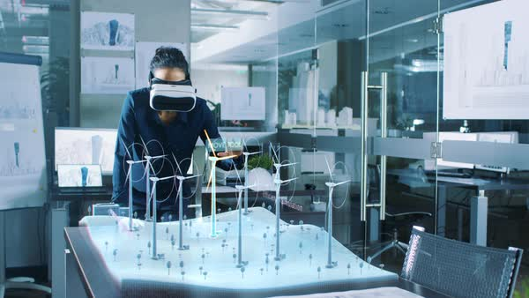
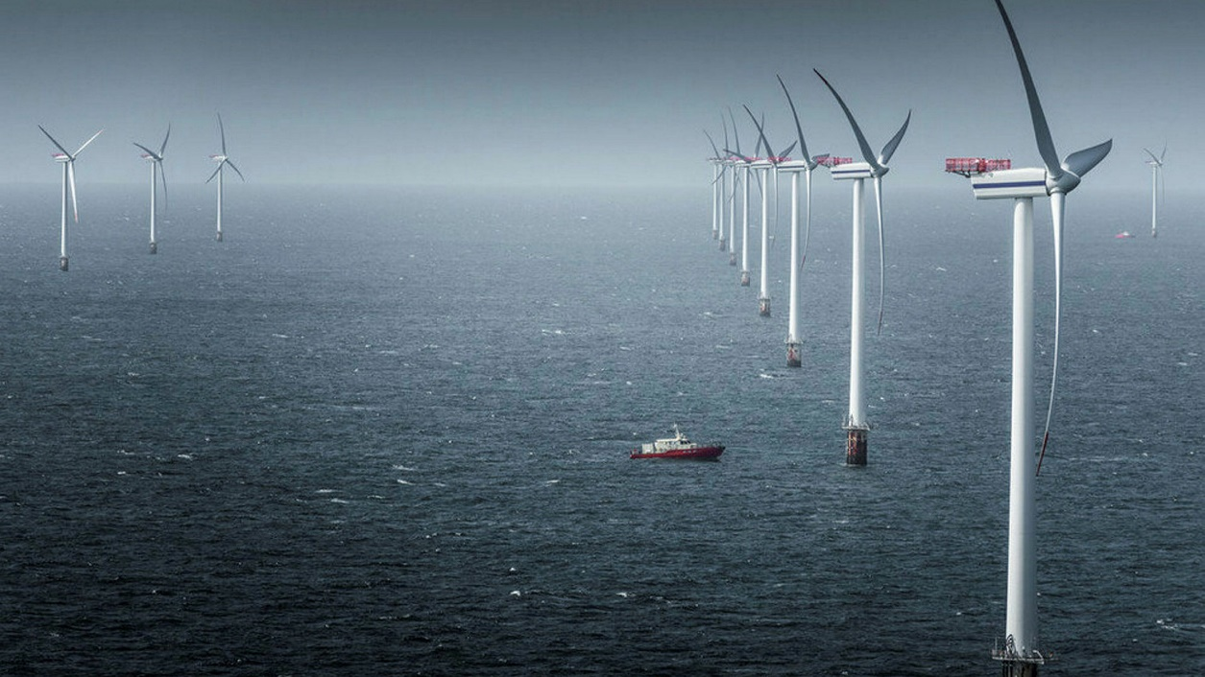
CONCEPTUAL DIAGRAM USE CASE - OFFSHORE WIND FARM CONDITION BASED MONITORING USING METAVERSE
IoT
(Wind Speed, Bearing Temperature, surface defects, Vibration, alarms, wind pressure)
Applications
(SCADA, DCS, CMS)
Engineering Data
(3D Model)
Corrosion, damage or fatigue of sub-structures are resulting in reduced lifetime of equipment
Cable failures due to movements, temperatures, or loads outside design parameters of equipment
Loss of production, either stop in production or production downtime due to cable or other asset integrity issues
Sub-optimal replacement scheduling; repairing or replacing equipment due to age rather than actual status of equipment
Metaverse using digital twin using real time, historical data IoT Streams
Holistic immersive 3D view of the offshore wind farms and operating conditions
Advanced collaboration features, team members can virtually inspect and review
Monitoring of bottom-fixed and floating wind turbines, substructures, detection of turbine anomalies
Equipment fault prediction.
Weather Data
(Wind, RH, temperature, pressure)

Slide 3
STEP BY STEP FLOW
 | Metaverse application for condition monitoring and maintenance of Wind Farm
1 | Collect real-time data (physical & operational parameters) of wind mills through IoT Gateway
2 | Data sources - Sensors (bearing temp/ vibration, casing temp/ vibration, blade vibration, ambient temp, wind speed, pedestal vibration, blade alignment, blade erosion), Wind SCADA, GIS (location), asset attributes (ERP), Lidar or Thermal camera (3D rendering & image data), maintenance history (ERP)
3 | Use metaverse platform (TBD) and HoloLens2 (worn by site supervisor and maintenance expert - both sitting remotely, for remote 3D view of wind turbine under surveillance, through HoloLens2)
4 | Both the site supervisor and expert interact through their Metaverse avatar to examine the condition of the wind turbine.
5 | Using Metaverse, they interact dynamically with the asset being examined, and check the real-time asset attributes/ operating parameters, to take real-time decisions.
6 | Once the expert notices any anomaly during inspection, he guides the maintenance site supervisor on what needs to be done.
7 | After discussing with expert on the nature of anomaly/ defect identified, the supervisor invokes ERP and raises work order, schedule job and resources to get the problem fixed.
8 | The same Metaverse platform can be used for training of field maintenance workforce at different locations, using the trainer, who can be at a remote location.

Slide 4


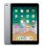
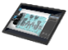
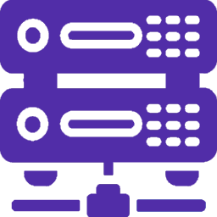

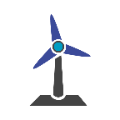


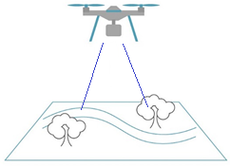

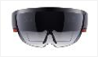
ARCHITECTURE - WIND FARM CBM USING METAVERSE WITH DIGITAL TWIN
Client’s Scope
Capgemini Offering
ERP
FIELD SUPPORT |INSPECTION
Weather Data
Resource Data
IoT Gateway
Cloud IoT Platform
Field Support Inspection
Sensor Data
Ambient temp, pressure, humidity, wind speed & direction
IoT HUB
WFM
Machine Data(Vibration, Temperature)
Scheduler
REST API
EAM/GIS
Asset Management & Map Service Inputs
IPAD or Android Device
IoT Sensor
AI/ML Model
OPC UA- Client
SME
Electrical (Power, V, I), Bearing/ Gearbox/ Nacelle temp., vibration
DB Connect
WIND FARM
WIND SCADA
NoSQL DB
Predict Windmill health condition
& wind energy production
DIGITAL TWIN
Field Support, Inspection, maintenance
LiDAR/
Thermal/
Visual Camera
CLOUD STORAGE
Storage API
REST API
Field Engineer
Point Cloud/Image/Video
Metaverse
Wearable Device
HoloLens

Slide 5
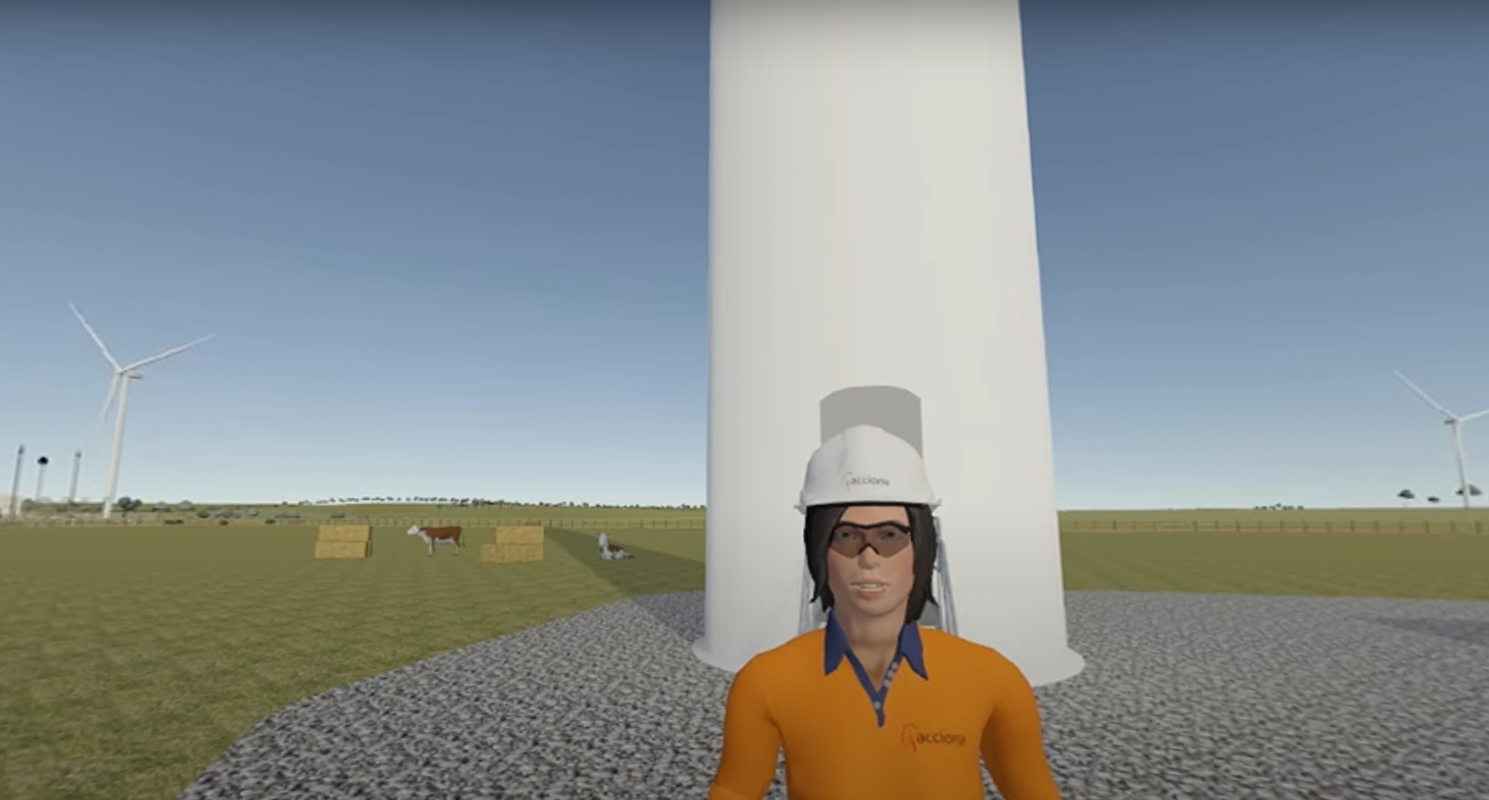

Slide 6
